Slide 1
DESIGN LANGUAGE
A PRESENTATION ON PRESENTATIONS

Slide 2

WE EXIST IN AN AGE OF
INFORMATION OVERLOAD
“There was 5 Exabytes of information created between the dawn of civilization through 2003, but that much information is now created every 2 days, and the pace is increasing.”
Eric Schmidt – former Google CEO
Our projects are not the only thing our clients have to manage.
Managing info fatigue must be part and parcel of what we do. We deal in information. We present information. Our stock in trade is representing the information we collect such that it aids the client’s ability to make a decision.

Slide 3
OBJECTIVE: DECREASE THE
INFORMATION BURDEN
We want to give our clients their results in an accessible manner. Success is measured by the ability to show these data to anyone in their organization – from senior executives to product reps – and have them grasp what they are seeing with just a few minutes of explanation.
Notes:
Gladwell, Malcolm. Blink : the power of thinking without thinking. New York: Back Bay Books, 2007.

Slide 4
INTELLIGENT
DESIGN
Our goal should always be to decrease the burden the data glut has on our clients. We must make it easy to read, understand, digest, and utilize the material we present.
Easy to read and digest: Presentations must achieve project objectives while minimizing information overload.
Communication is key: Effective communication combined with clear, concise graphics enables participation from all parties regardless of technical ability or background

Slide 5
Context & Objectives
Design Concepts
1. Be True to the Data
2. Tell a Story
3. Consider Data-Ink Ratio
4. Color Theory
5. Font & Legibility
Appendix

Slide 6
1
Be True to the Data

Slide 7
1 | Scale appropriately.
2 | Help the eye compare the data.
3 | Data accuracy must be depicted visually.
4 | Ensure the visuals tell the intended story.

Slide 8
TELL
Our clients hire us to do quality research and present the findings accurately. Our reputation, brand, and business are based on the faith and trust that we will do so.
Use quality survey methodologies
Don’t alter the raw data
Use quality analytical methods
Report the results accurately and with appropriate visual representation
THE TRUTH
Use the same scale every time
Start charts at the origin if possible

Slide 9



HELP THE EYE COMPARE THE DATA
In 1984, W.S. Cleveland published an article in JASA entitled, Graphical perception: Theory, experiments, and application to the development of graphical methods, in which he studied various forms of representing data. Key takeaways:
The human eye is great at comparing distances and heights, and understanding linear graphics
It’s not so great at judging or comparing angles, curves, area, or orthographic / “3D” graphics
“Judgements about position relative to a baseline are dramatically more accurate than judgments about angles, area, or length (with no baseline). Hence, he [Cleveland] suggests that we replace pie charts with bar charts or dot plots and that we substitute stacked bar charts for grouped bar charts.” ¹
Solomon Messing
Notes:
1 Messing, Solomon. “Visualization series: Insight from Cleveland and Tufte on plotting numeric data by groups" solomonmessing.wordpress.com. Web. 14 Oct. 2014.
For more: https://web.cs.dal.ca/~sbrooks/csci4166-6406/seminars/readings/Cleveland_GraphicalPerception_Science85.pdf

Slide 10

ENSURE VISUALS ACCURATELY
REPRESENT THE COMPARISON
Ensure that the shapes used to represent the data accurately represent the differences between the data points being compared
If X is twice Y, X should be represented by a bar that is twice as long/high as Y (if length is the comparative metric)
If possible, avoid using area to represent data; if you do use area, ensure you use area is the comparative metric and not length/height
x2

Slide 11
HELP THE EYE COMPARE
THE DATA: PIE CHARTS
While our eyes have difficulty comparing angles and distances along a curve, we understand area proportions with up to 4 or 5 pieces. Thus, pie charts may be acceptable means of displaying information for up to 5 breaks; however, a bar chart should be used if there are more than 5 breaks.
Notes:
http://www.excelcharts.com/blog/data-visualization-excel-users/excel-charts-pie-charts/

Slide 12
HELP THE EYE COMPARE
THE DATA: PIES AND DONUTS
Use a Pie Chart when comparing between 2 and 5 distinct breaks
Donut Charts are permissible ONLY when comparing a Fit/Not-fit binary (i.e., % NY vs. % not NY)
Avoid Pie Charts if comparing >5 distinct breaks
Notes:
http://www.excelcharts.com/blog/data-visualization-excel-users/excel-charts-pie-charts/

Slide 13
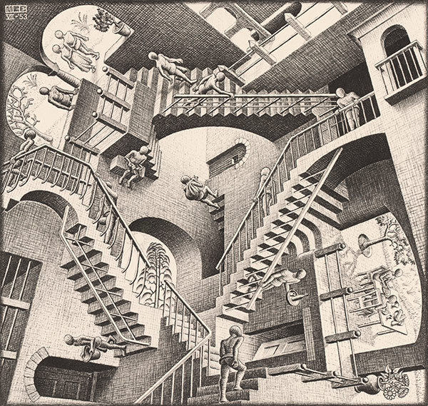
HELP THE EYE COMPARE
THE DATA: AVOID 3D
We’re trying to help the eye compare data, not to confound the brain and eye
PowerPoint’s representation of 3D data leaves much to be desired
Inconsistent scales and orthographic perspective
Confusion between length, area, and volume
Does it not sum to 100%? (It should)
Notice how 50% line is around NY on the left and CT on the right
Relativity¹
Notes:
1. M.C. Escher. “Relativity,” 1953. http://www.mcescher.com/gallery/impossible-constructions/relativity/ Web. 14 Oct. 2014.

Slide 14
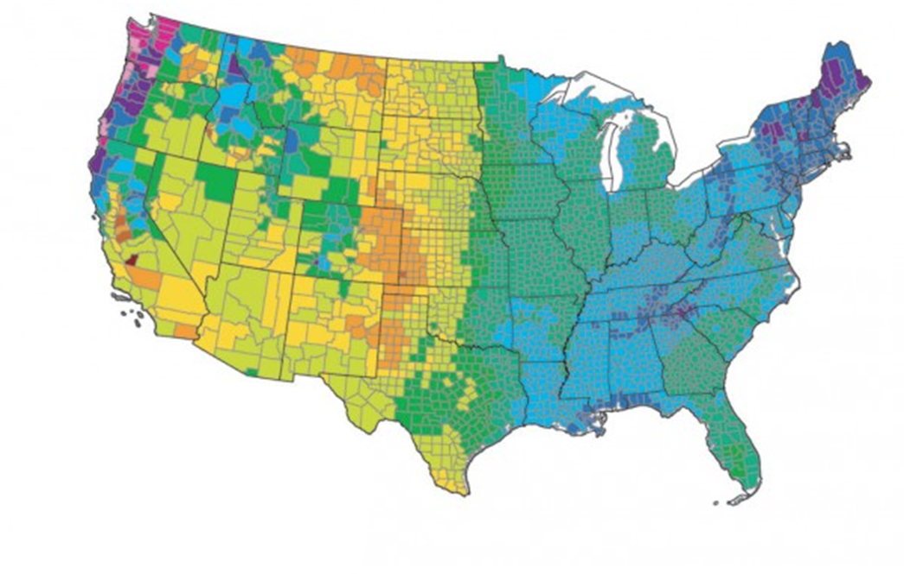
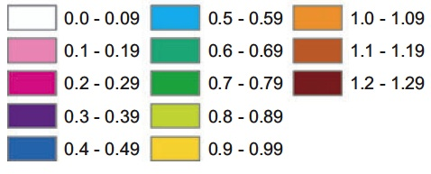

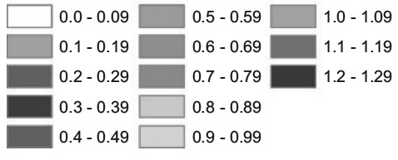
AVOID MISLEADING BY
CHOOSING COLOR CAREFULLY
Estimated fraction of precipitation lost to evapotranspiration
1971-2000
Current Scale
Current Scale - Luminance
At first glance, this looks like a significant shift because of the very visual change in color intensity. Additional time is needed to review the key and identify it represents only a small change.
Notes:
https://eagereyes.org/basics/rainbow-color-map

Slide 15
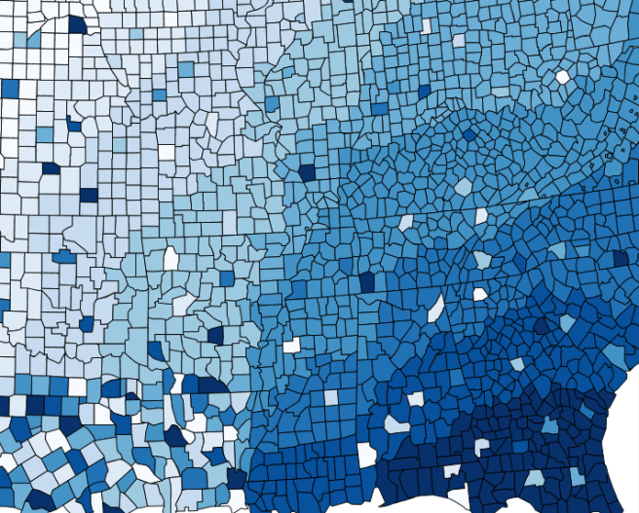
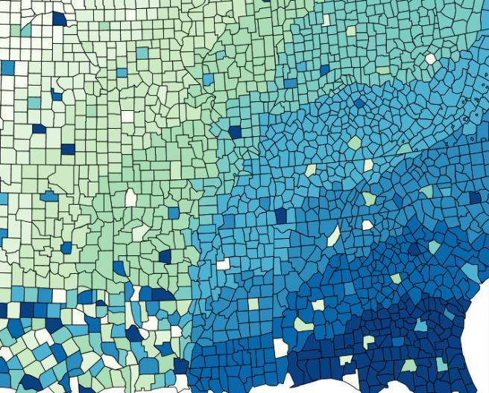
CHOOSE COLOR CAREFULLY
Single Hue Color Scheme
Uses different saturations or values of single color
Pro: Effectively shows difference without creating artificial distinctions
Con: Bland. Cannot search for or identify individual values easily.
Single Hue
Dual Hue Color Scheme
Uses different saturations or values of two colors
Pro: Same as Single Hue; also easier than single hue scheme to identify individual values
Con: Depending on number of gradients, cannot search for or identify individual values easily. May be challenging for colorblind viewers.
Dual Hue
Notes:
https://eagereyes.org/basics/rainbow-color-map
http://colorbrewer2.org/#

Slide 16
HELP THE EYE COMPARE
THE DATA: SUMMARY
 | Demo | Best to Show | Application
Shape |  | Qualitative difference | Categories; indicating different phases / categories in a flowchart
Size |  | Quantitative differences
Hue RGB / CMYK |  | Qualitative difference | Categories (i.e., product classes, brands)
Intensity/Saturation Brightness or Force of the color |  | Qualitative difference | Differences within one category (i.e., products w/in a class, progression over time)
Value Lightness or Darkness of color |  | Qualitative difference | Differences within one category (i.e., products w/in a class, progression over time)
Notes:
http://blog.plot.ly/post/125942000947/how-to-analyze-data-6-useful-ways-to-use-color-in

Slide 17
2
Tell A Story

Slide 18
1 | Let the Story lead the Visual.
2 | Create a structure
3 | Show Trends, not Specifics (unless required)

Slide 19
TELL A
STORY
Data is our friend. On a fundamental level, the job of an analyst is to collect and analyze data in such a way that it contributes to a positive decision-making process.
Our clients may not be as at home with data. They:
Need to know what it means – our reports must be intelligent and educational.
Need to know what to do – our presentations must be actionable.
Thus, we must present the data in such a way that it is useful.
We have to put the data in context.
We must tell a story.
Notes:
Each slide should aid one of these two goals
If I drop a deck on the floor and the pages scatter, the goal is that each slide can stand on its own and tell an individual story without the rest of the deck, but still contribute to the overarching story and intelligence developed in the

Slide 20
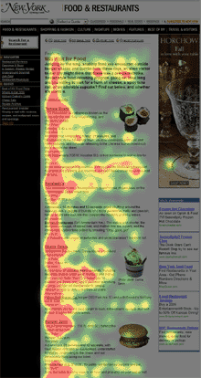
DESIGN VISUALS
AROUND CONTENT
Item Placement: If people read top down, left to right, then items on top or left of the page will be viewed first*.
Use this to structure the view order (i.e., organize items by importance, etc.).
*Eyes will be drawn to images / color before text
Notes:
*That said, eyes will always be drawn to images / color before text, so text that must be read prior to the graphic may best be located on a slide prior to the graphic.

Slide 21
DESIGN VISUALS AROUND CONTENT
Consider the data and the key comparisons you want to show when deciding how to organize the slide– Do you need to show:
Change over time for the class?
By brand?
Differences across respondent groups?
Then, show only what you need to communicate your point.
Notes:
http://www.excelcharts.com/blog/why-dont-like-bar-charts/

Slide 22
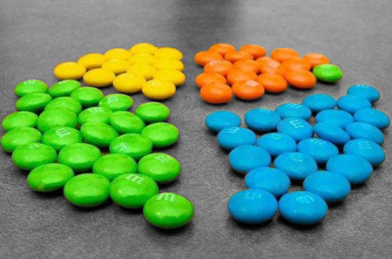
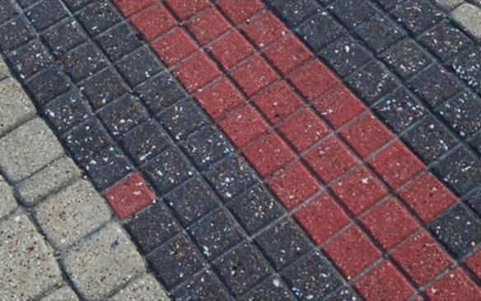
CREATE STRUCTURE TO
AID STORYTELLING
Create and use themed elements and structures throughout the presentation to provide a framework that allows for rapid recognition of data shown.
For recurring products, companies, or respondent groups, use common elements so its representation remains consistent throughout
Represent recurring products/brands with same color throughout
“Flag” or “theme” presentation segments for recognition

Slide 23
DON’T FALL VICTIM TO
CONWAY’S LAW
Organizations which design systems… are constrained to produce designs which are copies of the communication structures of these organizations.
Conway’s Law
Implication:
It is typical to display outputs in a format that mimics “the organization” (i.e., questionnaire flow, a specific methodology, or the org chart).
Application:
Be aware of the research objectives and the best manner in which to address the objectives. It may not be ideal to simply report following the questionnaire design or show “typical” outputs for a given methodology.

Slide 24
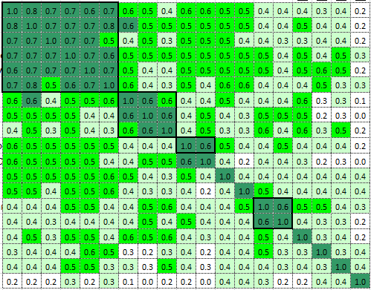
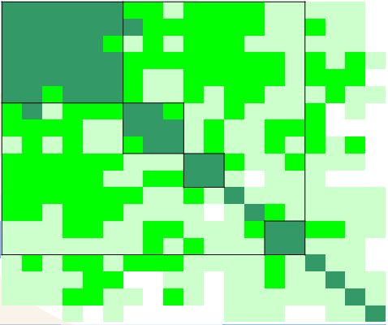
FOCUS ON TRENDS,
NOT SPECIFIC NUMBERS
Individual data are never the key to a well-informed decision. Trends and comparisons provide context that helps drive decision- making. When individual data are shown, it often leads the presentation astray. Avoid the weeds by focusing on trends and comparisons, not specific numbers.

Slide 25
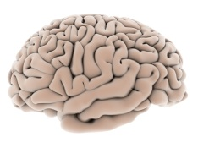
APPLY MILLER’S LAW
FOR CHUNKING AND ORGANIZATION
The maximum number of pieces of information a human brain can manage concurrently is about 7.
Miller’s Law
Application:
Organize presentation (summary slides, objectives, analysis points, etc.) by structuring to aid “chunking” - between 3 and 7 items per component
When designing stimuli and surveys, apply the same structure theory (sections, attribute lists, etc.)
Notes:
Note: this applies to lists that require recall: 7 +/-2 applies to working memory. Miller’s Law does NOT need to apply to standard, written text if there is no recall requirement following
http://psychclassics.yorku.ca/Miller/
http://www.wikiwand.com/en/The_Magical_Number_Seven,_Plus_or_Minus_Two
http://uxmyths.com/post/931925744/myth-23-choices-should-always-be-limited-to-seven

Slide 26
3
Be Aware of Data-Ink Ratio

Slide 27
1 | Dense data is acceptable (and even encouraged).
2 | Maximize data-ink ratio.
3 | Use tables. Effectively.
4 | Use PowerPoint’s powers for good.

Slide 28
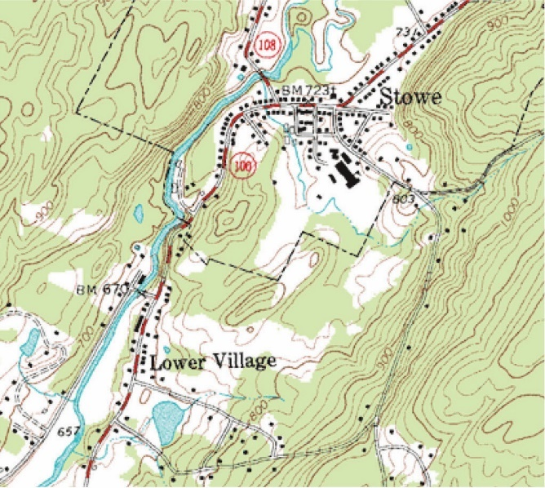
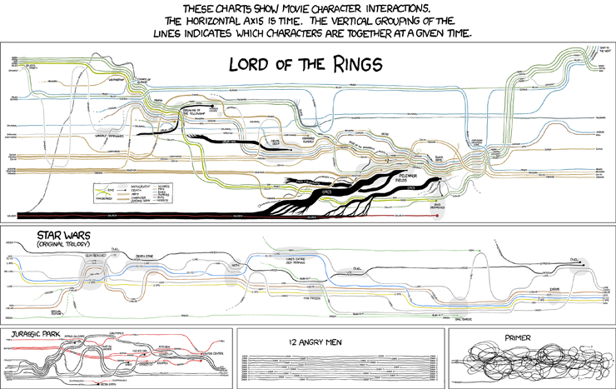
DO NOT FEAR
DENSE DATA
“Visual displays rich with data are not only an appropriate and proper complement to human capabilities, but also such designs are frequently optimal. If the visual task is contrast, comparison, and choice – as so often it is – then the more relevant information within eyespan, the better.” ¹
Dense data is actually a desirable attribute in presentations IF density serves a purpose.
Topographical Map²
Movie Narrative Charts³
Notes:
1 Tufte, Edward R. Envisioning Information. Cheshire, CT: Graphics, 1995. 50. Print.
2 Demaj , Damien and Field , Kenneth. “Map Examples, Figure 38.“ ICA Commission on Map Design. Web. 7 Oct. 2014.
3 Munroe, Randall. “Movie Narrative Charts" XKCD, no. 657. Web. 7 Oct. 2014.

Slide 29
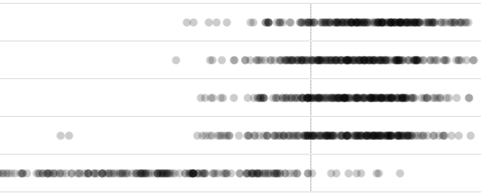
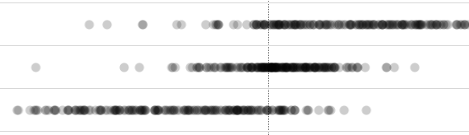
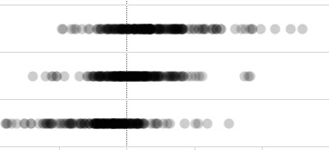
USE
Brand A
SMALL MULTIPLES
Brand B
Brand C
Brand D
“Small multiples are an excellent architecture for showing large quantities of multivariate data.”¹
Brand E
3-monthly
Monthly
“Small multiples resemble frames of a movie: a series of graphics, showing the same combination of variables, indexed by changes in another variable.”²
2x/month
Both
Maintenance
Acute
Notes:
1 Tufte, Edward R. The Visual Display of Quantitative Information, 2nd ed. Cheshire, CT: Graphics, 2011. 169. Print.
2 Tufte, Edward R. The Visual Display of Quantitative Information, 2nd ed. Cheshire, CT: Graphics, 2011. 168. Print.

Slide 30
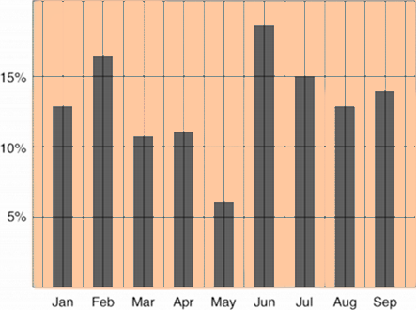
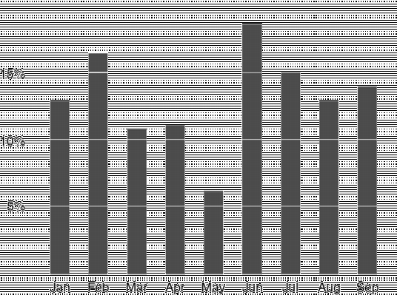
LIMIT INK THAT DOESN’T
CONTRIBUTE TO DATA DISPLAY
“A large share of ink on a graphic should present data-information, ink changing as the data change. Data-ink is the non-erasable core of a graphic, the non-redundant ink arranged in response to variation in the numbers represented.”¹
Goal: Maximize the data-ink ratio, within reason
Erase non-data-ink, within reason
Erase redundant data-ink, within reason
Notes:
1 Tufte, Edward R. Envisioning Information. Cheshire, CT: Graphics, 1995. Ch 5. Print.
Images borrowed with appreciation from Tim Bray’s illustration of data-ink ratio: http://www.tbray.org/ongoing/When/200x/2003/03/13/Data-Ink
Bray, Tim. “The Data-Ink Ratio Example" ongoing. Web. 7 Oct. 2014.

Slide 31
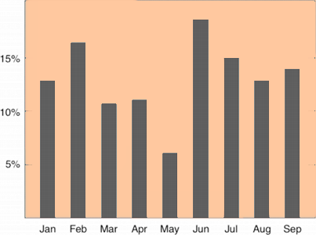
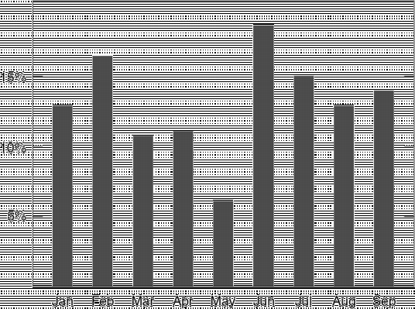
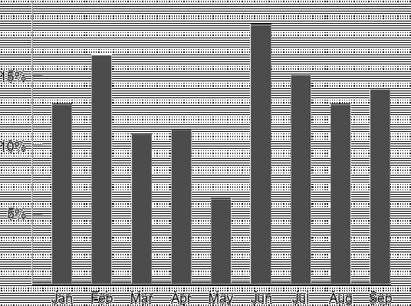
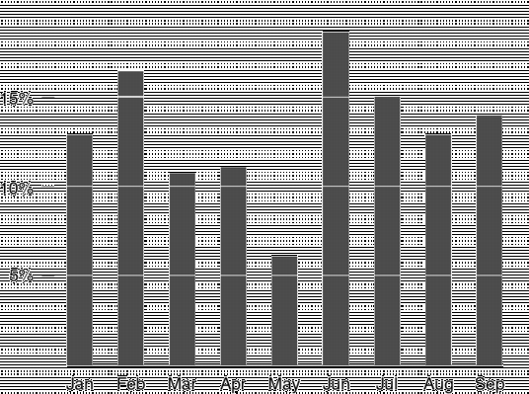
MAXIMIZING THE
DATA-INK
Notes:
Images borrowed with appreciation from Tim Bray’s illustration of data-ink ratio: http://www.tbray.org/ongoing/When/200x/2003/03/13/Data-Ink
Bray, Tim. “The Data-Ink Ratio Example" ongoing. Web. 7 Oct. 2014.

Slide 32
APPROPRIATE USE:
TABLES
It is preferable to use tables (instead of charts) when:
Audience needs to look up / compare individual values
Clients require precise values
Values involve multiple units of measure
Avoiding 3-D charts
Country | Population (millions) | Area Sq. km (thousands)
Germany | 80.99 | 243.6
United Kingdom | 63.74 | 35.0
Liechtenstein | 0.04 | 0.2

Slide 33
HELP TABLES HELP
YOU
Country | Germany | United Kingdom | Liechtenstein
Population | 80,996,685 | 63,742,977 | 37,313
1
Put data to be compared in columns, not rows
2
Right-align data in columns
Country | Population | Population | Population | Population (millions)
Germany | 80,994,685 | 80,994,685 | 80,994,685 | 80.99
United Kingdom | 63,742,977 | 63,742,977 | 63,742,977 | 63.74
Liechtenstein | 37,313 | 37,313 | 37,313 | 0.04
3
Remove excess digits / unnecessary precision

Slide 34
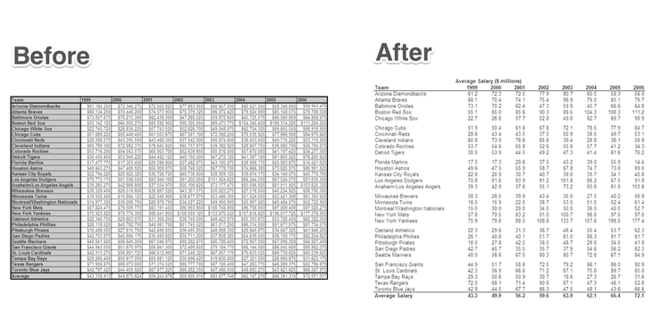
TABLES HAVE
CHART JUNK, TOO
After
Before
Note: white space breaks for grouping, removal of background color, removal of extra digits/precision
Notes:
http://www.juiceanalytics.com/writing/10-ways-to-reduce-to-improve-your-data-visualizations

Slide 35
REMOVE POWERPOINT’S
UNNECESSARY EFFECTS
Outlines, drop shadows, and 3D effects
Will
In
The
Get
Way

Slide 36
INCONSISTENCY
DISTRACTS
1) Here we see that rounded rectangles radius the corners differently depending on rectangle area.
2) Manually adjusting the corners takes time, but leads to a more consistent visual style
3) Squared rectangles do not have the additional step of adjusting corner radius to show consistency
4) Squared rectangles provide greater text area as corners can be fully utilized
Consistent white space
5) Maintain consistent white space – especially for spaces on the same 90° plane – unless it presents problems relating to other objects on the slide
7) Ensure items are aligned left/right/center and/or top/middle/bottom
6) Item alignment is also important

Slide 37
4
Color Theory

Slide 38
1 | Review your color theory.
2 | Color relationships add meaning.
3 | Consider Kelly’s 22 colors of maximum contrast.

Slide 39
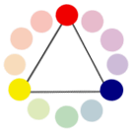



COLOR THEORY:
COLOR WHEEL
Primary Colors: Colors at their basic essence; those colors that cannot be created by mixing others.
Secondary Colors: Those colors achieved by a mixture of two primaries.
Tertiary Colors: Those colors achieved by a mixture of primary and secondary hues.
Notes:
http://www.tigercolor.com/color-lab/color-theory/color-theory-intro.htm
http://worqx.com/color/color_wheel.htm

Slide 40





COLOR THEORY:
SIMILAR RELATIONSHIPS
Monochromatic Relationship Colors that are shade or tint variations of the same hue.
Analogous Colors: Those colors located close together on a color wheel.
Notes:
http://worqx.com/color/combinations.htm
http://www.tigercolor.com/color-lab/color-theory/color-theory-intro.htm
http://www.smashingmagazine.com/2010/02/08/color-theory-for-designer-part-3-creating-your-own-color-palettes/

Slide 41






COLOR THEORY:
COMPLEMENTARY RELATIONSHIPS
Complementary Colors: Those colors located opposite each other on a color wheel.
Split-Complementary Relationship: One hue plus two others equally spaced from its complement.
Double-Complementary Relationship (aka Tetradic): Two complementary color sets; the distance between selected complementary pairs will effect the overall contrast of the final composition.
Notes:
https://color.adobe.com/create/color-wheel/?base=2&rule=Custom&selected=0&name=My%20Color%20Theme&mode=rgb&rgbvalues=0.6901960784313725,0.7333333333333333,0,1,0.47843137254901963,0.0392156862745098,0,0.5137254901960784,0.5019607843137255,0.5058823529411764,0.19607843137254902,0.45098039215686275,0,0.43529411764705883,0.5882352941176471&swatchOrder=0,1,2,3,4
http://paletton.com/#uid=75b0W0ky1vgkTISqkBpy7nfDAg4
http://worqx.com/color/combinations.htm
http://www.tigercolor.com/color-lab/color-theory/color-theory-intro.htm
http://www.smashingmagazine.com/2010/02/08/color-theory-for-designer-part-3-creating-your-own-color-palettes/

Slide 42
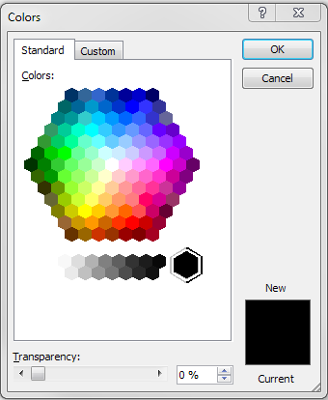

COLOR THEORY:
HUE AND VALUE
Hue:
Use for: Categories (i.e., product classes, brands)
Value:
Shade: A hue produced by the addition of black. Tint: A hue produced by the addition of white.
Use for: Differences within one category (i.e., products w/in a class, progression over time)
hue
value
Notes:
“strong” colors (high saturation, middle value) activate negative space (whitespace)
Consider color contrasts.
B&W is actually harder on the eyes/harder to read then white & dk grey.
Strong colors will overwhelm weaker ones, which can be imputed to align with importance or add’l interpretation (which may be unintentional / incorrect)
Super-strong colors (fire engine red, neon orange) are to be avoided unless there is a specific STRONG reason for using such a strong color

Slide 43
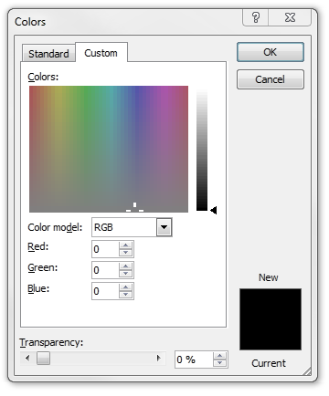
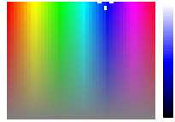
COLOR THEORY:
HUE, SATURATION, AND VALUE
Hue:
Use for: Categories (i.e., product classes, brands)
Saturation:
Use for: Differences within one category (i.e., products w/in a class, progression over time)
Value:
Shade: A hue produced by the addition of black. Tint: A hue produced by the addition of white.
Use for: Differences within one category (i.e., products w/in a class, progression over time)
hue
saturation
value
Notes:
“strong” colors (high saturation, middle value) activate negative space (whitespace)
Consider color contrasts.
B&W is actually harder on the eyes/harder to read then white & dk grey.
Strong colors will overwhelm weaker ones, which can be imputed to align with importance or add’l interpretation (which may be unintentional / incorrect)
Super-strong colors (fire engine red, neon orange) are to be avoided unless there is a specific STRONG reason for using such a strong color

Slide 44
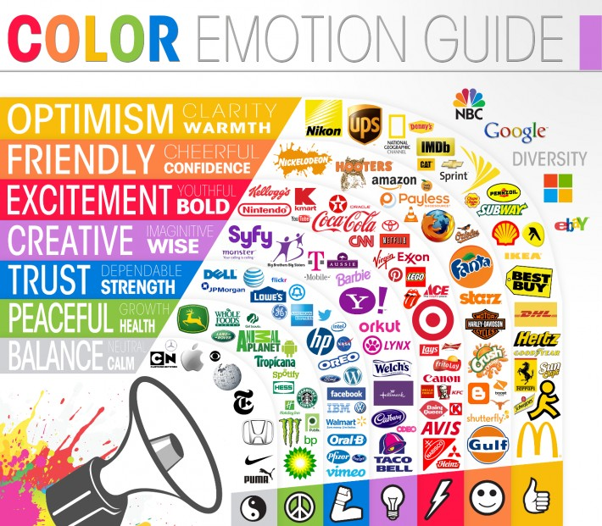
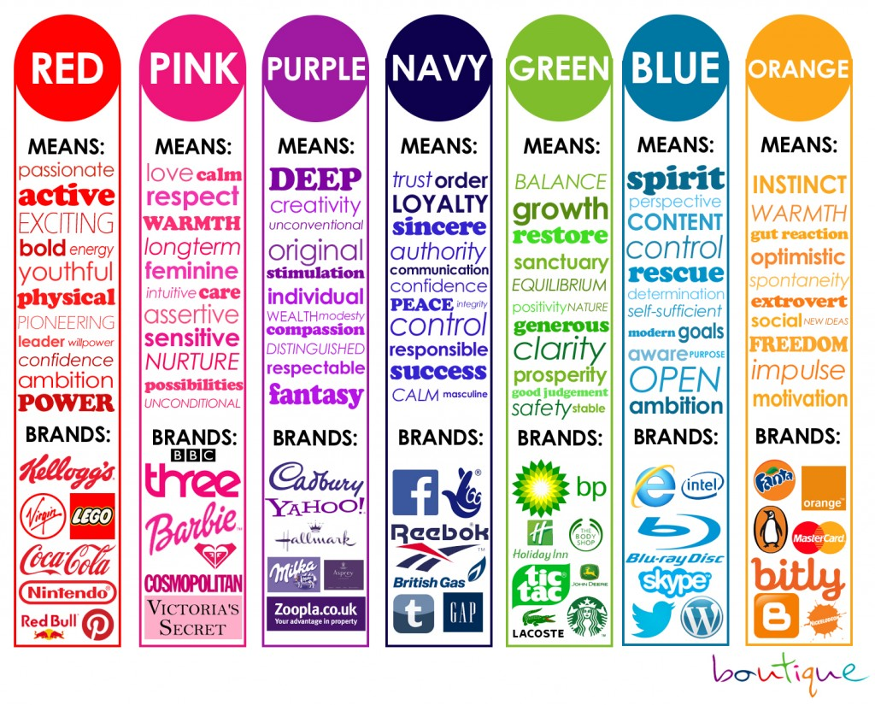
CONSIDER ASSOCIATIONS WHEN
SELECTING COLOR
Notes:
http://www.incredibleart.org/lessons/middle/color2.htm
http://mwpdigitalmedia.com/blog/psychology-colour-video-post-production/
http://www.colormatters.com/color-symbolism
http://www.zevendesign.com/color-association/

Slide 45
KELLY’S 22 COLORS OF
MAXIMUM CONTRAST
# | Color | Name | R | G | B
1 |  | White | 242 | 243 | 244
2 |  | Black | 34 | 34 | 34
3 |  | Yellow | 243 | 195 | 0
4 |  | Purple | 135 | 86 | 146
5 |  | Orange | 243 | 132 | 0
6 |  | Light Blue | 161 | 202 | 241
7 |  | Red | 190 | 0 | 50
# | Color | Name | R | G | B
8 |  | Tan | 194 | 178 | 128
9 |  | Grey | 132 | 132 | 130
10 |  | Green | 0 | 136 | 86
11 |  | Pink | 230 | 143 | 172
12 |  | Blue | 0 | 103 | 165
13 |  | Salmon | 249 | 147 | 121
14 |  | Violet | 96 | 78 | 151
# | Color | Name | R | G | B
15 |  | Tangerine | 246 | 166 | 0
16 |  | Berry | 179 | 68 | 108
17 |  | Greenish Yellow | 220 | 211 | 0
18 |  | Reddish Brown | 136 | 45 | 23
19 |  | Grass Green | 141 | 182 | 0
20 |  | Brown | 101 | 69 | 34
21 |  | Red Orange | 226 | 88 | 34
22 |  | Olive Green | 43 | 61 | 38
In the event that highly contrasting colors are needed, Kelly’s 22 Colors of Maximum Contrast might offer a good selection.
Recommended use places colors next to each other in the order indicated by number.
Notes:
http://hackerspace.lifehacker.com/some-os-x-calendar-tips-1658107833/1665644975/+whitsongordon?utm_campaign=socialflow_lifehacker_twitter&utm_source=lifehacker_twitter&utm_medium=socialflow

Slide 46
5
Font & Readability

Slide 47
1 | Consider readability.
2 | Apply a standard font framework.
3 | Avoid comic sans (and some other font advice).

Slide 48
CONSIDER READABILITY
FOR MAXIMUM COMPREHENSION
If your audience cannot read text instantly, they won’t try.
Improve comprehension with easy-to-read text and easy-to-decipher charts, graphs, and graphics.
Legibility is the ease with which a reader can recognize individual characters in text. "The legibility of a typeface is related … to the ability to distinguish one letter from the other."
Readability is the ease with which a reader can recognize words, sentences, and paragraphs. Legibility is a component of readability.

Slide 49

FONT AND BACKGROUND COLORS:
HIGH CONTRAST = GOOD RESULTS
To obtain the best readability, choose either a very light font on a very dark background or vice versa.
“On that color wheel my definition of Very Light is ‘Snow White’ in the center and the Six Dwarfs touching Snow White. All the Very Dark colors are on the last two rows furthest from Snow White, although NOT every color swatch on those last two rows is dark.”¹
This means that 470 high-contrast color combinations exist: [ 2(7*35) ].
Note: Not ALL of these 470 high-contrast (light/dark // dark/light) color combinations are readable! You must also consider the brightness /luminosity of the colors and their placement on the color wheel (i.e., red and blue/green are difficult to make readable).
Notes:
1. Finkelstein, Ellen. “Choose fonts and colors for legibility" EllenFinkelstein.com, July 10th, 2002. Web. 7 Oct. 2014.
http://www.webreference.com/dlab/9704/backgr.html
http://www.colortools.net/color_text_on_background.html
http://sapdesignguild.org/goodies/diagram_guidelines/textcolor_bk.html#Anchor1

Slide 50
A SIMPLE FONT FRAMEWORK
DEFINITIONS
Header Text
The majority of text falls into four categories:
Body text is clean, readable content
Headers separate and name major sections of your work
Notes describe additional things the reader should be aware of. These should fade into the background unless we call attention to them.
Emphasis text is what we want our reader to pay particular attention to.
Notes
Body Text
Emphasis

Slide 51
A SIMPLE FONT FRAMEWORK
SUGGESTED FORMATTING
 | Purpose | Size | Font | Color | Style
Body | Clean, readable text 50-80% of your text will look like this | 10-18 pts | Sans-serif: Arial, Calibri Serif: Georgia, Cambria | Neutral | Normal No bold, no italic 1.2 line spacing
Header | Separate and name major sections | 150%-200% of body | Same as body or flip serif/sans-serif | Neutral | Normal, bold, or italic Whitespace above
Notes | Additional things audience should be aware of: data sources, metric calculations “Fade into the background” | 85% of body | Same as body | De-emphasized, lower contrast | Normal, thin
Emphasis | Draw the eye to key points you need to make | Same as body | Same as body | Choose one or both
 |  |  |  | High impact color | Bold or italic
Notes:
http://www.juiceanalytics.com/writing/make-your-text-readable-with-4-easy-tips

Slide 52
A SIMPLE FONT FRAMEWORK
OTHER FORMATTING
 | Purpose | Size | Font | Color | Style
Body | Clean, readable text 50-80% of your text will look like this | 10-18 pts | Sans-serif: Arial, Calibri Serif: Georgia, Cambria | Neutral | Normal No bold, no italic 1.2 line spacing
Header | Separate and name major sections | 150%-200% of body | Same as body or flip serif/sans-serif | Neutral | Normal, bold, or italic Whitespace above
Table Header | Titles and separates table segments | 100%-150% of table text size | Body with a dash of header style | Neutral | Normal, bold, or italic Whitespace above
Graph Title | Titles graphs and charts | 100%-150% of graph text; Body size | Header style | Neutral | Normal, bold, or italic Whitespace above

Slide 53
FONT FORMATTING
ADDITIONAL SUGGESTIONS
Suggestion: Use a serif font for body text.
Studies indicate that an audience may trust a serif typeface more than a sans-serif typeface because newspapers and textbooks have typically be written in serif fonts.
Suggestion: Use a sans-serif font for heading and title text
If we follow our Font Framework and use a serif font for body text, then we should use a sans-serif font for the headline and title text
Suggestion: Consider font qualities for maximum legibility in small text size for charts and graphs
Gill Sans, Tahoma, & Segoe UI are all highly legible in small font size
AVOID COMIC SANS or any other font based on handwriting-mimicry
Notes:
http://usabilitynews.org/a-comparison-of-popular-online-fonts-which-is-best-and-when/
http://alexpoole.info/blog/which-are-more-legible-serif-or-sans-serif-typefaces/
http://www.smashingmagazine.com/2010/05/06/50-helpful-typography-tools-and-resources/
http://www.smashingmagazine.com/2009/08/20/typographic-design-survey-best-practices-from-the-best-blogs/
http://net.tutsplus.com/tutorials/html-css-techniques/typography-on-the-web/

Slide 54
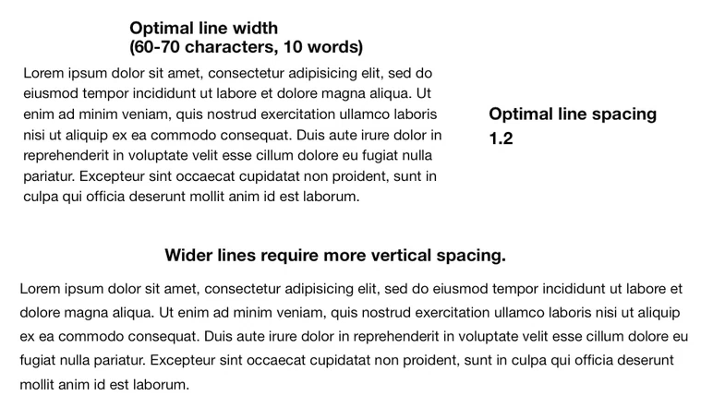
OPTIMIZE LINE LENGTH
AND SPACING WHEN POSSIBLE
Studies show that shorter lines (45-80 characters) and wider line spacing (1.2x font size) ease the transition from the end of one line to the beginning of the next, enhancing readability.
Notes:
http://www.smashingmagazine.com/2014/09/29/balancing-line-length-font-size-responsive-web-design/
http://www.screencast.com/t/MTAzNDhl

Slide 55
6
ADDITIONAL MATERIALS

Slide 56
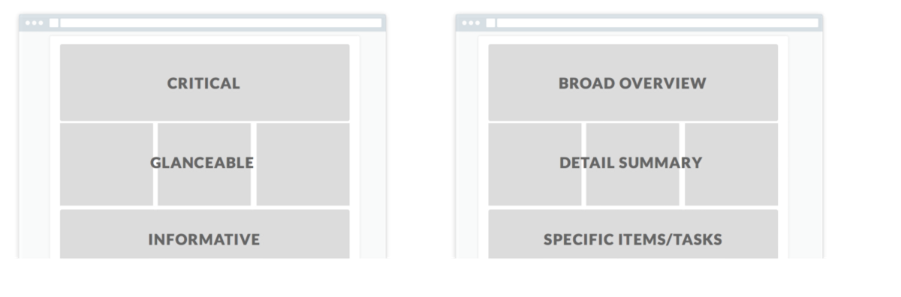
Show the user what they need to see first, then structure the remainder of the page based on the user story or hierarchy of information.
Notes:
https://medium.com/truth-labs/designing-data-driven-interfaces-a75d62997631?ref=webdesignernews.com

Slide 57
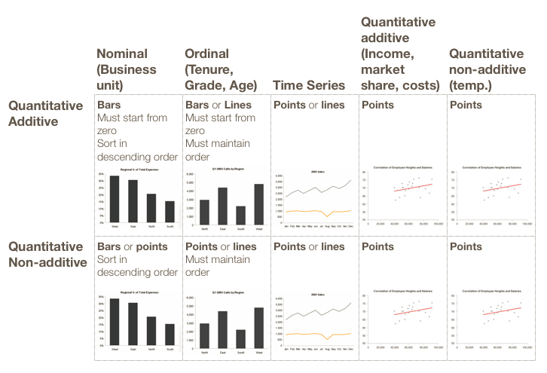
Notes:
Juice Analytics Guide to Dashboard Design
http://labs.juiceanalytics.com/chartchooser/index.html

Slide 58
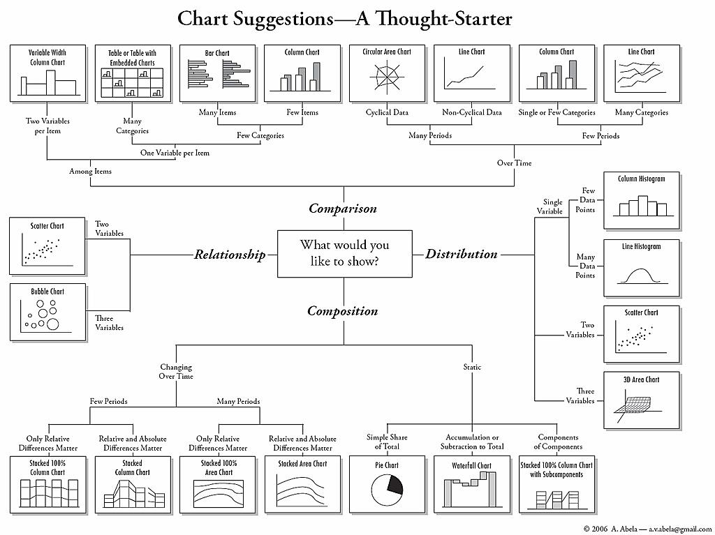
Notes:
Image from: http://www.labnol.org/software/find-right-chart-type-for-your-data/6523/ or http://extremepresentation.typepad.com/blog/2006/09/choosing_a_good.html
Also, see:
http://labs.juiceanalytics.com/chartchooser/index.html
http://www.dummies.com/how-to/content/how-to-choose-the-right-chart-type-in-excel-2010.html
http://pic.dhe.ibm.com/infocenter/cx/v10r1m0/index.jsp?topic=%2Fcom.ibm.swg.ba.cognos.dsk_ug.10.1.0.doc%2Fc_dsk_charts_types.html
http://www.tutorial9.net/tutorials/web-tutorials/selecting-the-right-chart-type-for-your-data/

Slide 59
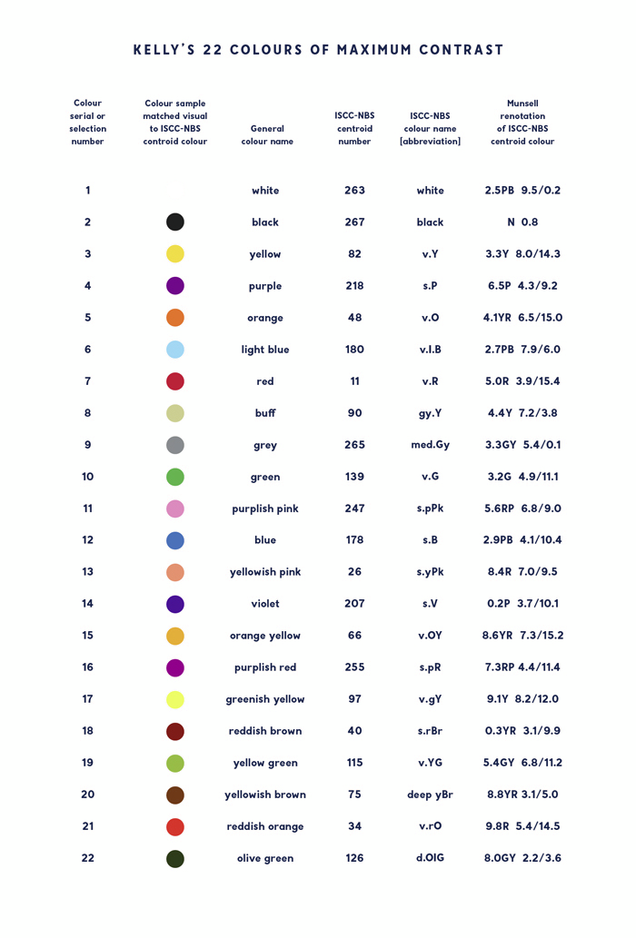
iscc-nbs number | Hex | R | G | B
263 | F2F3F4 | 242 | 243 | 244
267 | 222222 | 34 | 34 | 34
82 | F3C300 | 243 | 195 | 0
218 | 875692 | 135 | 86 | 146
48 | F38400 | 243 | 132 | 0
180 | A1CAF1 | 161 | 202 | 241
11 | BE0032 | 190 | 0 | 50
90 | C2B280 | 194 | 178 | 128
265 | 848482 | 132 | 132 | 130
139 | 008856 | 0 | 136 | 86
247 | E68FAC | 230 | 143 | 172
178 | 0067A5 | 0 | 103 | 165
26 | F99379 | 249 | 147 | 121
207 | 604E97 | 96 | 78 | 151
66 | F6A600 | 246 | 166 | 0
255 | B3446C | 179 | 68 | 108
97 | DCD300 | 220 | 211 | 0
40 | 882D17 | 136 | 45 | 23
115 | 8DB600 | 141 | 182 | 0
75 | 654522 | 101 | 69 | 34
34 | E25822 | 226 | 88 | 34
126 | 2B3D26 | 43 | 61 | 38
Notes:
https://eagereyes.org/basics/rainbow-color-map
http://hackerspace.lifehacker.com/some-os-x-calendar-tips-1658107833/1665644975/+whitsongordon?utm_campaign=socialflow_lifehacker_twitter&utm_source=lifehacker_twitter&utm_medium=socialflow

Slide 60
FONT AND BACKGROUND COLORS
FOR THE MATHEMATICALLY MINDED
Goal: Ensure that foreground and background color combinations provide sufficient contrast when viewed by someone having color deficits (1/10 males may be blue/green colorblind) or when viewed on a black and white screen.
The W3C (World Wide Web Consortium) suggest the following definition and formulas to make this quantifiable:
Two colors provide good color visibility if the brightness difference and the color difference between the two colors are greater than a given range.
Color brightness is determined by the following formula: ((Red * 299) + (Green * 587) + (Blue * 114)) / 1000
Color difference is determined by the following formula: Sum the difference of each color pair (max (Red 1, Red 2) - min (Red 1, Red 2)) + (max (Green 1, Green 2) – min (Green 1, Green 2)) + (max (Blue 1, Blue 2) - min (Blue 1, Blue 2))
The minimum range for color brightness difference is 125. The minimum value for color difference is 500.
Notes:
http://www.particletree.com/notebook/calculating-color-contrast-for-legible-text/
http://colorusage.arc.nasa.gov/legib_1.php

